Slide 1
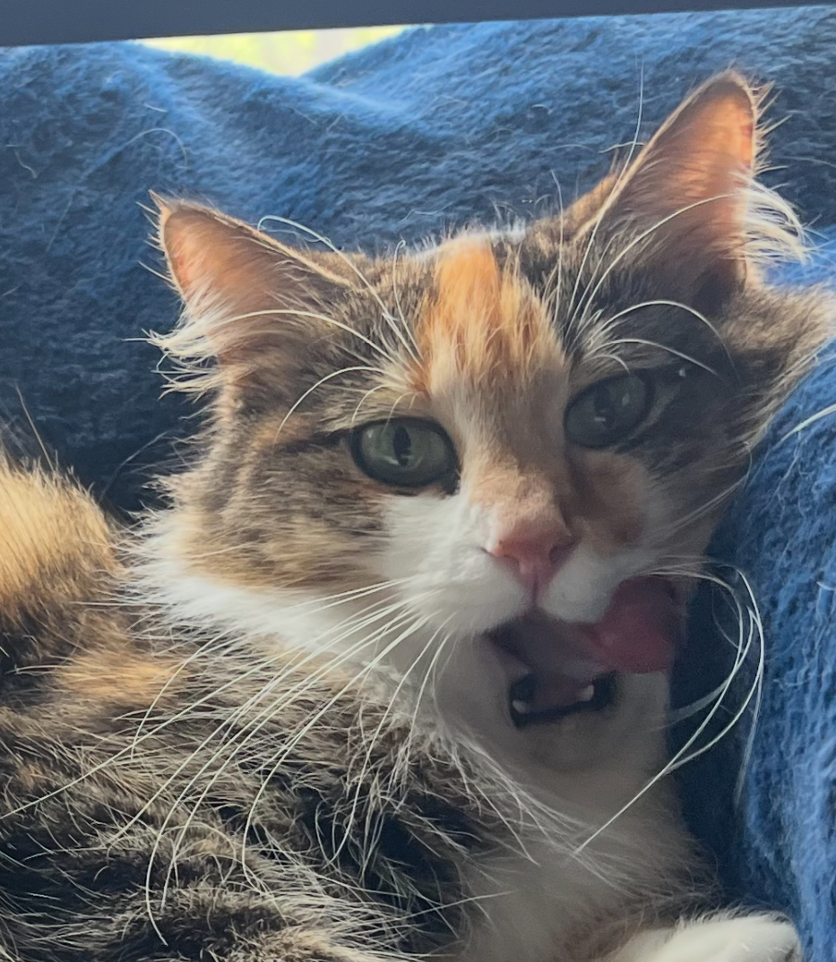
Rosie Wildlife Tracker
Fernando Alarcon, Vishvajit Senthilkumar, Tan Chau

Slide 2
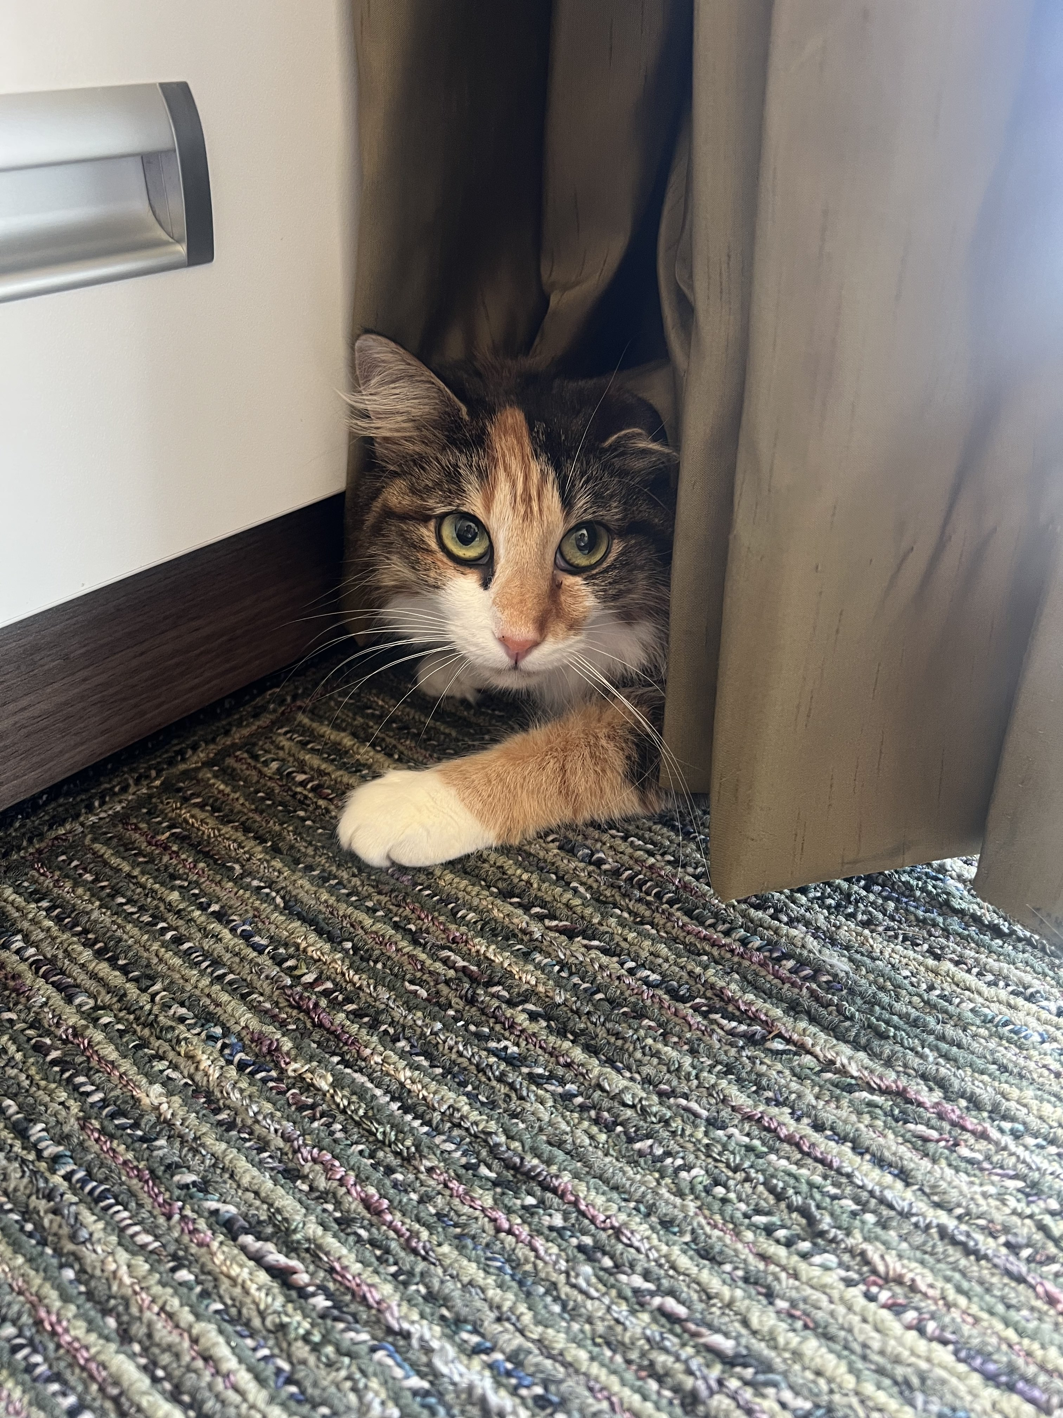
The Problem
Stray cats can have a significant impact on wildlife, especially birds, small mammals, and reptiles, by hunting and disrupting local ecosystems. Their presence often leads to a decline in native species, particularly in sensitive or urban-edge habitats. Rehoming stray cats not only helps protect wildlife but also improves the cats’ quality of life, giving them access to shelter, food, and medical care. Through responsible rehoming and adoption efforts, we can reduce the stray population, support animal welfare, and restore balance to local environments.

Slide 3
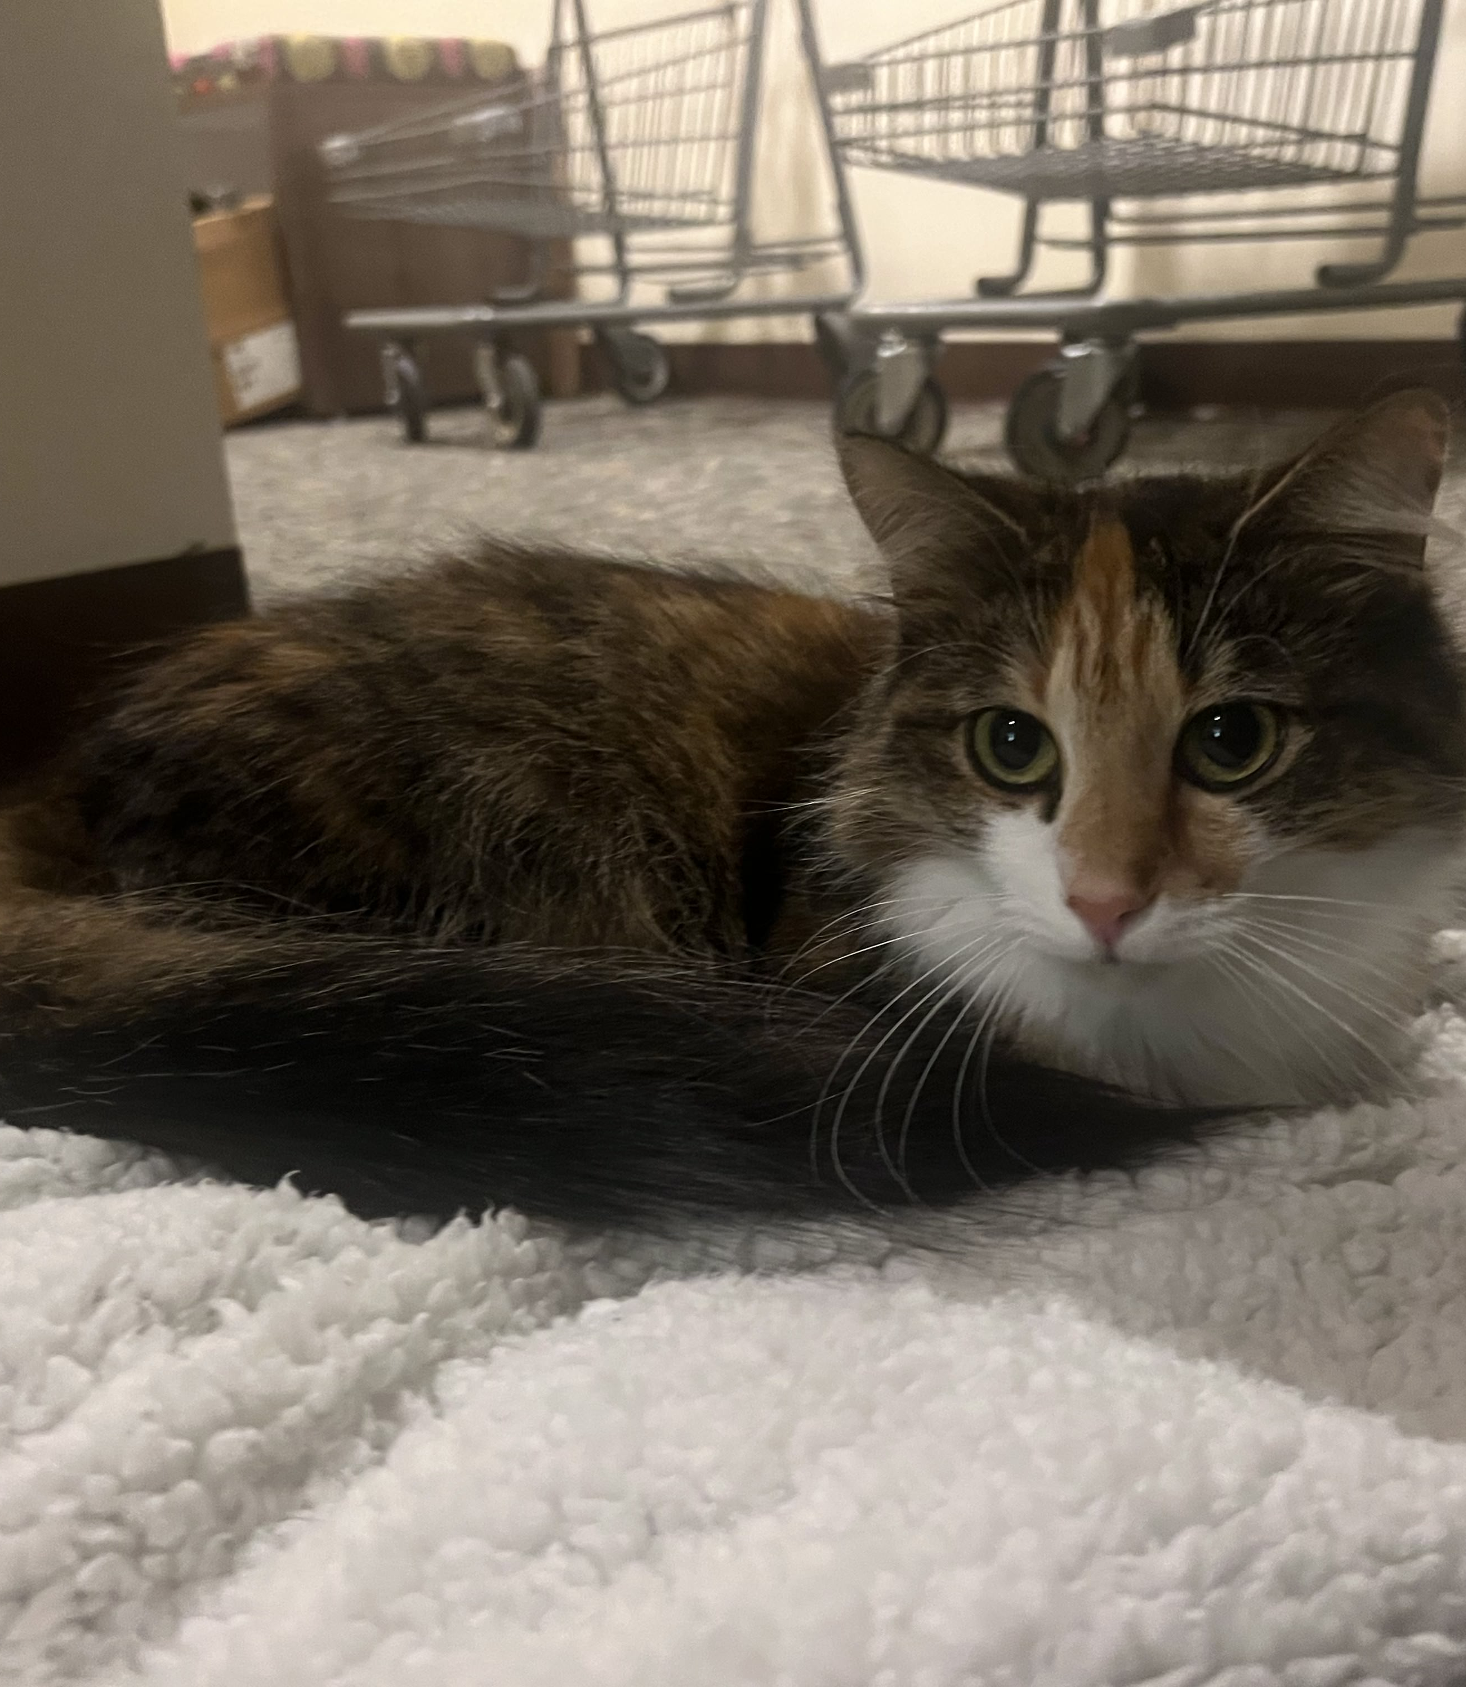
Our Project Mission
Our mission is to support wildlife conservation and research by developing smart, non-invasive tracking tools that combine movement, location, and physiological data. Using technology like the ESP32, motion sensors, heartbeat monitors, and GPS, we aim to provide researchers with real-time insights into animal behavior, health, and habitat use helping protect wildlife and preserve ecosystems more effectively, and find and capture animals such as stray cats to be rehomed.

Slide 4
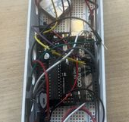
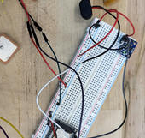
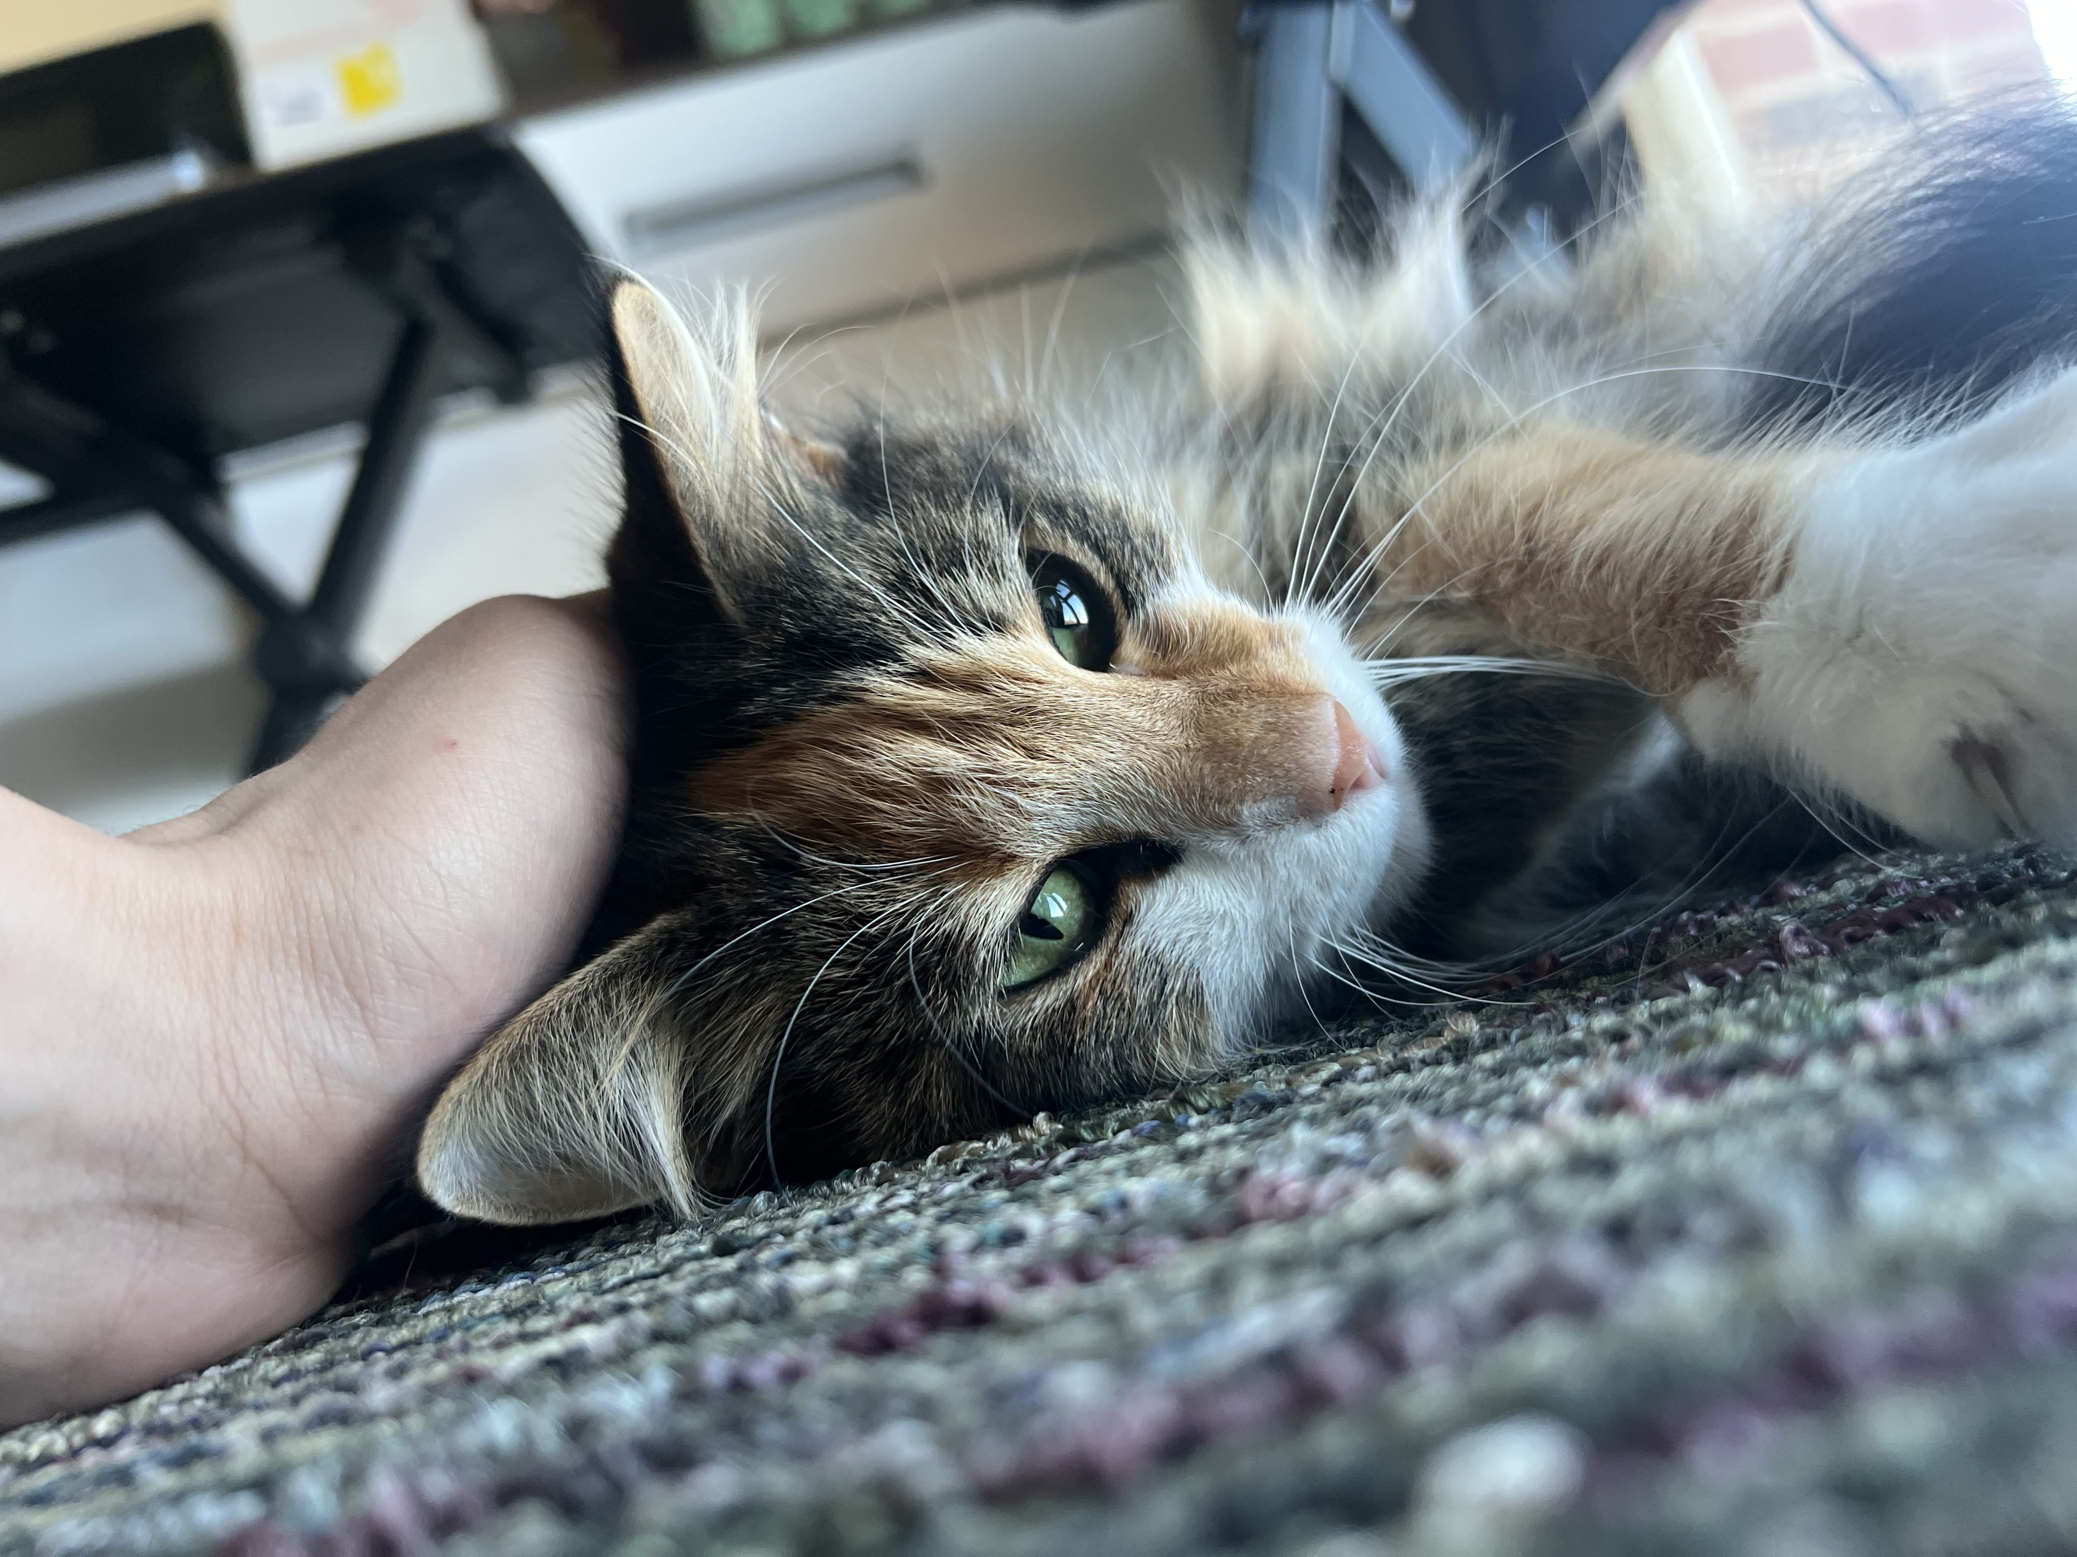
Achievements
Fully functional prototype with all sensors integrated
Compact, wearable casing for field use to be used with a harness
Live data successfully transmitted and displayed

Slide 5
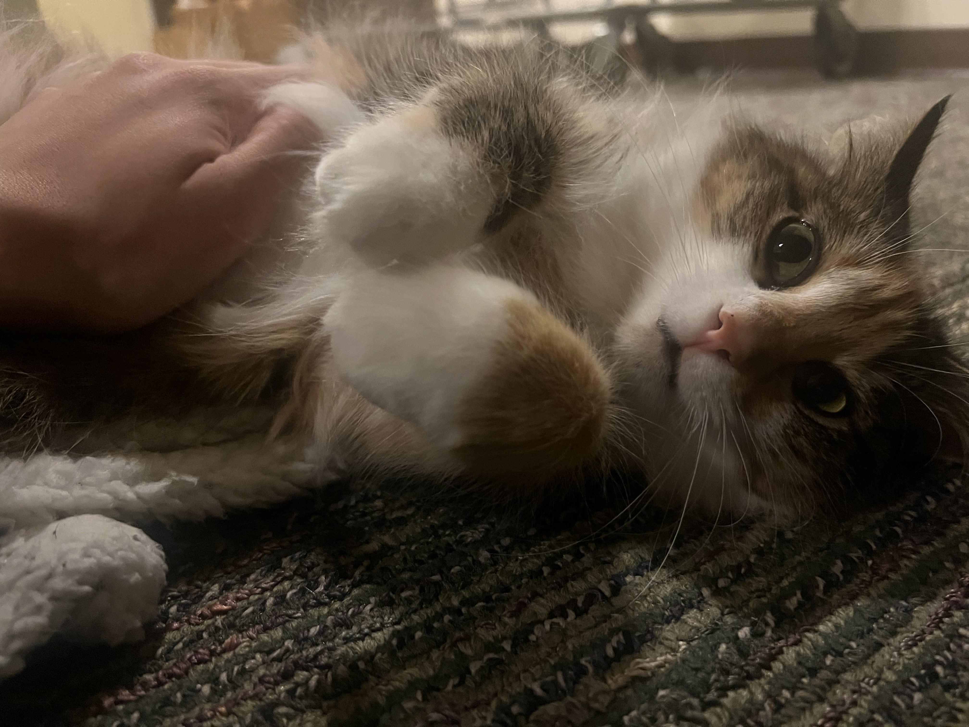
What’s Next for Rosie
Enhance ESP32-cloud communication for long-term deployment
Add AI to detect stress, health anomalies, and behavior changes
Publish live wildlife dashboards for public awareness
Integrate solar power and LoRa for off-grid wildlife zones

Slide 6
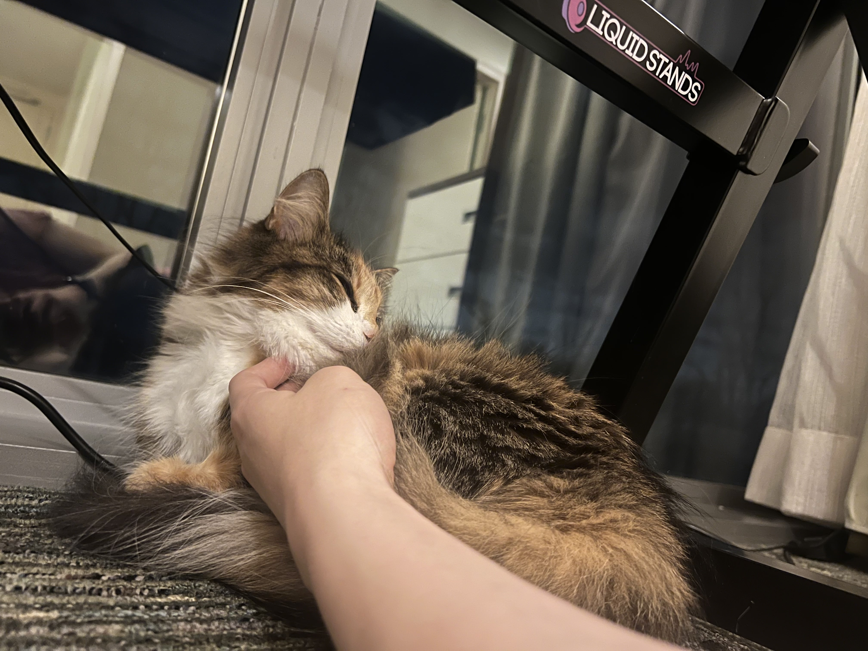
Our Impact
Rosie Tracker bridges the gap between animals and data
Helps researchers, ecologists, and communities protect nature
Real-time insight into wildlife movement, health, and environmental interaction
Designed for scalability, sustainability, and smarter conservation

Slide 7
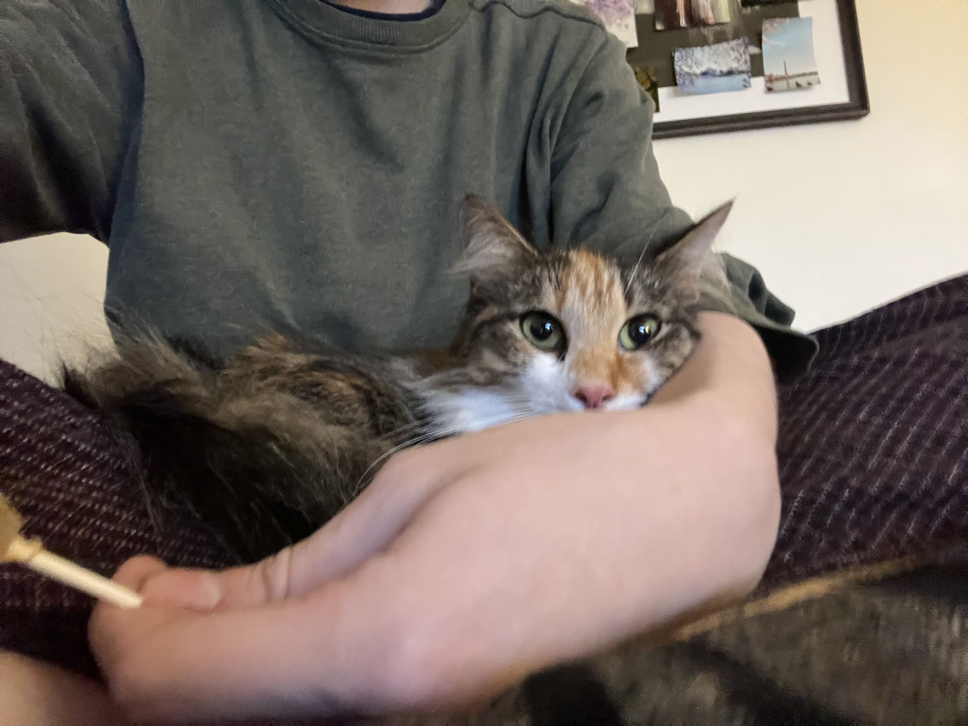
Thank You
Let’s build a better world—one heartbeat at a time.
Team: Tan, Vish, Fern
📍 Live demo available!

